Slide 1
Fundamentals of E-Commerce
SE-413
Week 2

Slide 2
E-Commerce has been Disruptive
It has caused major changes in the way business is conducted.
Industry Structure
Marketplace Structure
Business Models
Situation Analysis
Organizations need to monitor, understand and respond appropriately to changes in their online marketplace to capitalize on opportunities using digital technologies.

Slide 3
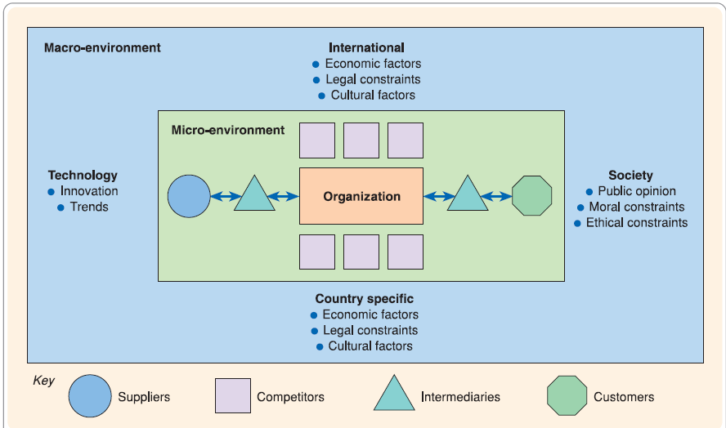
E-Commerce Environment
Macro
Micro

Slide 4
E-Commerce Environment
All organizations operate within an environment that influences the way in which they conduct business.
Strategy development should be strongly influenced by considering the environment the business operates in.
Shaped by the needs of customers and how services are provided to them through competitors and intermediaries and via upstream suppliers.
The capacity to respond to the environmental opportunities and threats is commonly referred to as Strategic Agility.

Slide 5
Online Marketplace Analysis
Analysis of the online marketplace is a key part of developing a long-term e-business plan or creating a shorter-term digital marketing campaign.
Customer Segmentation
Search Intermediaries
Media sites and 3rd party intermediaries
OVP

Slide 6
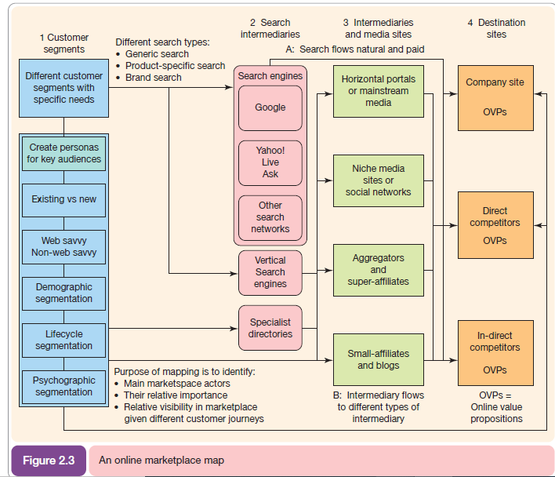
Online Marketplace Analysis

Slide 7
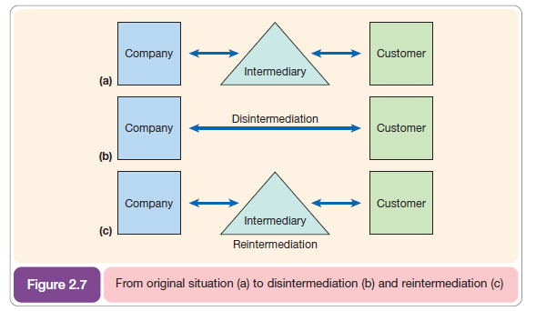
Disintermediation vs Re-intermediation
Removal or addition of intermediaries in a channel.

Slide 8
Multi-Channel Marketplace
E-Business using Multiple channels to conduct e-commerce.
Physical store
Website
Third Party Sellers (Online or otherwise)

Slide 9
Types of Intermediaries
Search Engines
Blogs
Business Directory
Marketplace or Auction sites
Price Comparison Site
Social Sites
Associations and Vendors sites

Slide 10
Online Business Model
Typically Comprises of 8 Elements
Value Proposition
Market or Audience
Revenue Model
Competitive Environment
Market Positioning
Online Representation
Organizational Structure
Management

Slide 11
Revenue Models
CPM (Cost per Thousands) Advertising
CPC Advertising
Sponsored Sections of Website
Affiliate (CPA or CPC)
Transaction Fee
Subscription
Pay Per View
Permitted Subscriber Data Auction/Sell

Slide 12
Valuing Internet Startup
A 6 step approach
Concept
Innovation
Execution
Traffic
Financing
Profile

